Slide 1
HTML + CSS 웹 사이트
이동규

Slide 2
목차
1.화면 구성
2.내비게이션 바
3.iframe
4. 소감
5.시연

Slide 3
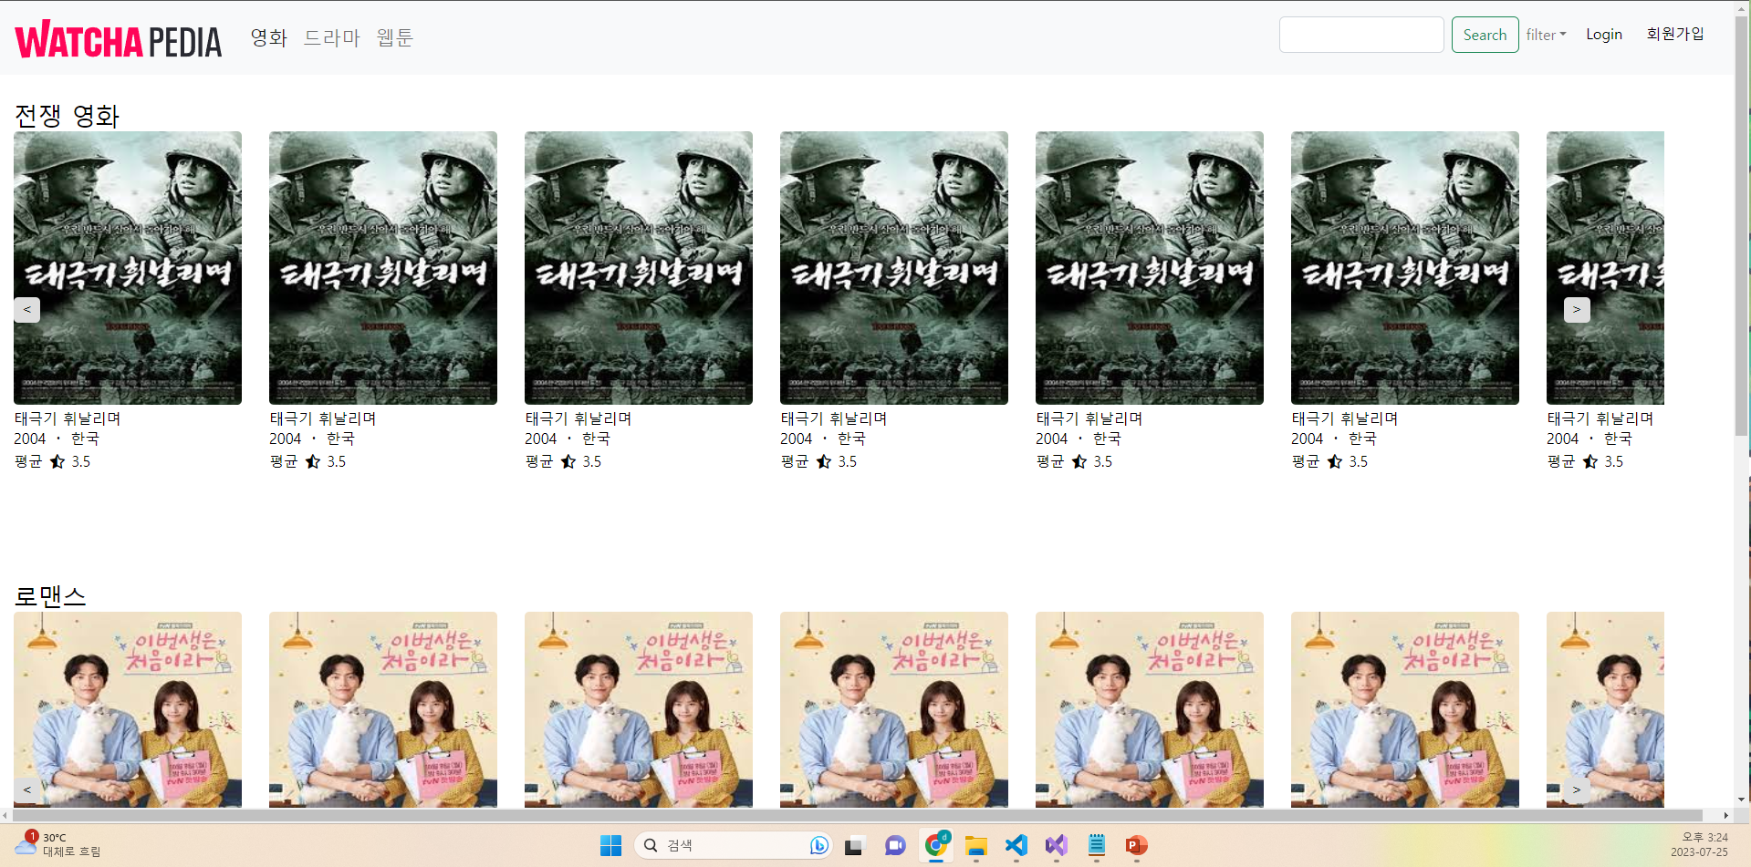
화면 구성

Slide 4
네이게이션 바
html
<a class="navbar-brand" href="index.html" target="view">
<img src="./로고.png" alt="">
</a>
<li class="nav-item">
<a class="nav-link active" href="movie.html" target="view">영화</a>
</li>
<li class="nav-item">
<a class="nav-link" href="drama.html" target="view">드라마</a>
</li>
<li class="nav-item">
<a class="nav-link" href="comic.html" target="view">웹툰</a>
</li>
<input class="form-control me-2" type="search" placeholder="" aria-label="Search" style="width: 20vh;">
<button class="btn btn-outline-success" type="submit">Search</button>

Slide 5
네이게이션 바
html
<li class="nav-item dropdown">
<a class="nav-link dropdown-toggle" data-bs-toggle="dropdown" href="#" role="button" aria-expanded="false" style="font-size: 12pt;">filter</a>
<ul class="dropdown-menu">
<li ><input type="radio" name="chk_info" value="로맨스" class="jangre-radio">로맨스<input type="radio" name="chk_info" value="재난" class="jangre-radio">재난</li>
<li ><input type="radio" name="chk_info" value="액션" class="jangre-radio">액션<input type="radio" name="chk_info" value="코미디" class="jangre-radio">코미디</li>
<li ><input type="radio" name="chk_info" value="스릴러" class="jangre-radio">스릴러<input type="radio" name="chk_info" value="다큐" class="jangre-radio">다큐</li>
</ul>
</li>
<li class="nav-item">
<button type="button" class="btn btn-light">Login</button>
</li>
<li class="nav-item">
<button type="button" class="btn btn-light">회원가입</button>
</li>

Slide 6

IFAME
html
<div class="jangre" style="padding-top: 100px;">전쟁 영화</div>
<div class="slider-container" id="slider-container">
<div class="slider-wrapper">
<div class="slide" id ="slider">
<a href="detail.html" target="view">
<div class="element">
<img src="image_movie/태극기휘날리며.jpg" alt="">
<div class ="title">태극기 휘날리며</div>
<div class="make-year">2004 ・ 한국</div>
<span>평균</span> <i class="fa-regular fa-star-half-stroke"></i> <span>3.5</span>
</div>
</a>
<div class="element">
<img src="image_movie/태극기휘날리며.jpg" alt="">
<div class ="title">태극기 휘날리며</div>
<div class="make-year">2004 ・ 한국</div>
<span>평균</span> <i class="fa-regular fa-star-half-stroke"></i> <span>3.5</span>
</div>
</div>
</div>
<div class="slider-controls">
<button onclick="slideToLeft(this)">&lt;</button>
<button onclick="slideToRight(this)">&gt;</button>
</div>
</div>

Slide 7
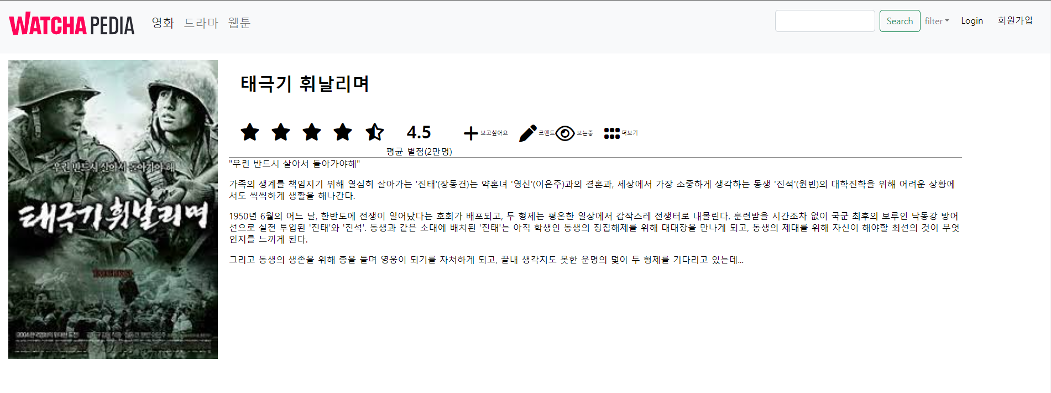
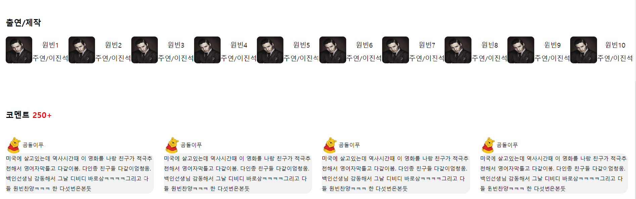
IFAME
html
<div style="display: flex; flex-wrap: wrap;">
<img src="image_movie/태극기휘날리며.jpg" alt="" class ="main-photo" id = "main-photo">
<div style="width: 70%;" id = "main">
<h1 style="padding-left: 20px;">태극기 휘날리며</h1>
<div class="review-div">
<div style="display: flex;">
<h1><i class="fa-solid fa-star"></i></h1>
<h1><i class="fa-solid fa-star"></i></h1>
...
<div class="score">
<h1 style="margin-bottom: 5px;">4.5</h1>
평균 별점(2만명)
</div>
</div>
<div style="display: flex; align-items: center;">
<h1><i class="fa-solid fa-plus symbol-icon"></i></h1> <span class = "icon-descript">보고싶어요</span>
<h1><i class="fa-solid fa-pen symbol-icon"></i></h1> <span class = "icon-descript">코멘트</span>
<h1><i class="far fa-eye symbol-icon"></i></h1> <span class = "icon-descript">보는중</span>
<h1><i class="fa-solid fa-grip symbol-icon"></i></h1> <span class = "icon-descript">더보기</span>
</div>
</div>
<section calss="point">
본문
</section>
</div>
</div>

Slide 8
IFAME
html
<section class="actor">
<h2 style="margin-bottom: 0px; padding-top: 100px;">출연/제작</h2>
<div class="actor-1">
<ul style="display: flex; flex-wrap: wrap; justify-content: flex-start;">
<li>
<div class="actor-div">
<img src="image_detail/원빈.jpg" class="photo">
<div>
<div class= "actor-descript"> 원빈1</div>
<div class= "actor-descript">주연/이진석</div>
</div>
</div>
</li>
<li>
<div class="actor-div">
<img src="image_detail/원빈.jpg" class="photo">
<div>
<div class= "actor-descript"> 원빈2</div>
<div class= "actor-descript">주연/이진석</div>
</div>
</div>
</li>

Slide 9
IFAME
html
<div class="comment" style="padding-top: 100px;">
<h2>코멘트 <span style="color: red;">250+</span></h2>
<div class="comment-div">
<ul style="display: flex; flex-wrap: wrap;">
<li class = "review-li">
<div class = "review-box">
<div class="user">
<img src="./image_detail/프로필.jpg" alt="" class ="profile" style="border-radius: 30px; width: 50px; height: 50px;">
<div>곰돌이푸</div>
</div>
<div class="review">
미국에 살고있는데...
</div>
</div>
</li>
<li class = "review-li">
<div class = "review-box">
<div class="user">
<img src="./image_detail/프로필.jpg" alt="" class ="profile" style="border-radius: 30px; width: 50px; height: 50px;">
<div style="float: left;">곰돌이푸</div>
</div>
<div class="review">
미국에 살고있는데...
</div>
</div>
</li>

Slide 10


힘들었던 점
아쉬웠던 점
Input 사이의 간격
슬라이드의 순서가 1 -> 2-> … 9-> 1-> 2->식으로
끊기지 않고 이어지도록 만들기를 희망함

Slide 11
시연
https://resonant-kangaroo-7c1709.netlify.app

Slide 12
감사합니다.

